Slide 1
Work successfully in groups
Notes:
In the modules Responsibility and Methods, the students will develop projects in the form of group work. They will definitely encounter this way of working again in their future university careers.
With this session, they shall understand how groups work together most effectively and how they can organize themselves to reach a goal without many headaches.
Preparation: (suggesting a Belbin role for the other person) I recommend that you either print out the Belbin Role-sheet (in the materials folder) or make it available on MyStudy.

Slide 2
Why group work?
How does a team become capable of acting?
How can roles and tasks be distributed?
How do you manage the work process correctly?

Slide 3
What constitutes group work?
What are their opportunities, what are their challenges?
Notes:
Take 5mins, create a mind map for each question.
Example answers for 1:
several people
division of tasks
Interaction
self-organization (also interdisciplinary cooperation as a ubiquitous phenomenon in the world of work)
Answers for 2:
divide again into 2 mind maps (opportunities vs. challenges) on blackboard / whiteboard
point to treasures of experience from school days; for challenges: how were they solved? > make positive experiences strong!
Alternatively use MentiMeter, so that anonymous collection is carried out

Slide 4

2. How does a team become capable of acting?
The central factors for successful group work are...
Clear common goals
Functioning communication
Clear responsibilities
Notes:
Input from the tutor
What are the most important tips for effective teams that can and should be derived from the characteristics of groups and teams?
To 1.: Which tasks exist from the point of view of the team? Are these desirable, accepted, motivating and, above all, meaningful for the team? Is there agreement on paths and goals?
Re 2.: Does interaction and communication work as required and coordinated? Is information exchanged, tasks worked on together and coordinated, and are decisions made sensibly? Where are any barriers and what can improve interaction? (Topic of another session: 11.2 Nonviolent Communication & Social Lazing)
Re 3: Is there a meaningful, stable and conflict-free role differentiation? Are there clear responsibilities and limits of responsibilities? Are all team roles important for the task filled? > this will be discussed in the next section of the Belbin roles
If you are interested, find out more here: https://wpgs.de/fachtexte/gruppen-und-teams/team-gruppe-definition-merkmale-unterschied/#Tipps_fuer_handlungsfaehige_Teams

Slide 5

3. How can roles and tasks be distributed?
We clarify in the following...
What‘s my tick?
→ Big Five of personality
What role can/should I play in the team?
→ Belbin Roles
Notes:
Before we talk about how best to organize ourselves with others, we take a look at ourselves: what personality traits do we see for ourselves?
Based on this, in the second step we can consider which role we can take on in a group, and which ones do not make sense in any case due to character traits.

Slide 6
3. Die Big Five einer Persönlichkeit
Strongly pronounced
Weakly pronounced
inventive, curious
imaginative, inquisitive
Openness to experience
conservative, cautious
confident, quiet
relaxed
Neuroticism
emotional, nervous
misplaced, unsafe
effective, organized
planning, reliable
Conscientiousness
carefree, careless
inaccurate, spontaneous
friendly, compassionate
helpful, compliant
Agreeableness
Competitive
suspicious, combative
sociable, active
talkative, optimistic
Extraversion
reserved, reserved
independently
Notes:
For tutors:
First, you present this overview to the students. Afterwards, they could either take about 5mins to reflect on themselves (where do I classify myself?) or take an equivalent online-test (10mins long), e.g. here: bigfive-test.com – there‘s several language options.
Present the steps after one another, just as suggested by the animation. The following infos are side infos:
In principle, the more pronounced a characteristic, the more beneficial it is for group work. However, it should not be a question of understanding weaknesses as deficits and therefore having to change them. It is important to understand ourselves better in order to be able to work as stress-free as possible in contact with others.
Of course, the characteristics of the Big Five are also dependent on the form of the day. Emotional mood is just as important!
For group work: Therefore, it is always advisable to start the meeting with a "check in", i.e. roughly coordinate the current needs and emotional states. By knowing what's going on in each other's lives, we can better understand why they act and decide a certain way.

Slide 7

3. Belbin Roles
characteristic behavioral patterns in the team
problems:
  not performing a role
  unoccupied roles
  double cast roles
Belbin-Roles
Notes:
Now that we know which characteristics suit us particularly well, it's about orienting ourselves in groups.
You may no longer have the opportunity to optimally assemble your teams according to suitable character types. But an awareness of personalities and competencies can definitely make you more team-oriented.
Short input: In the 1970s, psychology professor Meredith Belbin studied the effects of team composition from different personality types on team performance. As a result, he developed the concept of nine team roles. He found that team structures are (can) be composed of certain role patterns. Such a team role refers to behavioral patterns that a member of the team shows, with whom he identifies and which the other team members expect from this person.
Problems arise when
1) the team member does not perform the role;
2) important roles are not filled;
3) several team members compete for the same role (e.g. coordinating the work)
according to Belbin, teams are particularly effective when a variety of personality types meet.

Slide 8
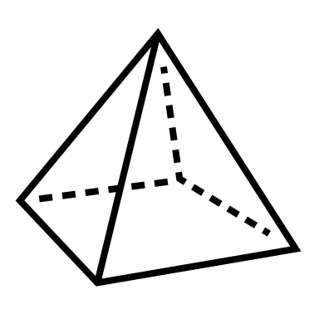








3. Belbin Roles
thinking
action
social
Plant
Generates ideas,
solves difficult problems
Shaper
has the drive to
overcome obstacles
Co-ordinator
delegates effectively
Monitor, Evaluator
Sees all options and
judges accurately
Implementer
turns ideas into actions
Teamworker
listens and averts friction
Specialist
Provides knowledge
and skills in rare supply
Completer, Finisher
polishes and perfects
Resource Investigator
explores opportunities and
develops contacts
Notes:
For Tutors: Present these roles.
There are three different types: thinking, action and social
Start with the thinking roles, then action, then social. The students should listen closely to write down which of their character traits fits a role. To remember they can take notes while you‘re talking.
First of all, three main directions can be distinguished: knowledge-oriented, task-oriented and human-oriented team roles.
thinking:
The plant brings in unconventional ideas, promotes new solutions and innovations with fresh thinking.
The monitor stands for judgment; they are the realists; they keep a distanced overview. They are sober, strategic and critical.
Specialists have specialist expertise. They are committed and self-centered.
action:
Shapers want to solve team improvements and problems; they are dynamic and work well under pressure.
Implementers start systematically. are disciplined, reliable and effective.
Completers bring things to perfection. They are conscientious and punctual.
social:
Co-ordinators stand for team leadership, they delegate tasks effectively. They are confident and trusting.
Team workers promote good cooperation. They pay attention to conflicts and resolve existing ones. They are cooperative and diplomatic.
Resource Investigators can network. They make important contacts outside the team. They are extroverted, communicative and sociable.
Understands these roles as orientations, not determined.
It can very well be that one person is suitable for several roles and takes them on in parallel.
The Belbin scrolls are a model that has been taken from empiricism and abstracted extensively. So not all roles have to be distributed!
At the same time, it is possible that the distribution of roles in the process will change.

Slide 9
Forms small groups (couples if necessary).
Tell the others what strengths you were able to find out in your personality test.
Your counterpart suggests suitable team roles and advises you against others.
Notes:
Put yourself in the role of a teamer. Form pairs of two for this. You tell each other about the result of your personality test, and your partner suggests roles that seem appropriate.
If it is unambiguous, certain roles may also be discouraged. Also uses the worksheet [AB Belbin rolls with detailed role contributions + characteristics] as a thought support. Then exchange ideas: would you have chosen the same role? Why?

Slide 10
In plenary:
Are you satisfied with your distribution of roles?
Do they coincide with the roles I take on in my current group work?
What were the difficulties?
Notes:
Important: Establish a connection to the group work of the seminars and let them reflect on whether conscious role assumption is taking place. Is there satisfaction? Would I like to take on a different role?
For large groups, exchange in small groups is also conceivable.

Slide 11
3. What does a process of group work look like?
Forming
Meet
Orientate
Get to know
Adapt
Storming
Take up space
Express different interests
Differentiate yourself
Norming
Establish rules
Simplify collaboration
Clarify procedure
Performing
Build trust
Take risks
Use differences productively
Notes:
Now that we know what makes teamwork effective and what tasks can be distributed, let's take a look at the whole process. It is important from the beginning to manage the group work correctly in order to reach the goal with as few obstacles as possible.
By now you are still at the beginning, but it is interesting where your path will still lead. To do this, we look at the team phases after Tuckman.
Bruce Tuckman developed this phase model in 1965. It helps us to understand the process of team building and to actively support it.
In the forming phase you meet for the first time. You get to know each other carefully and politely and explore boundaries.
In the storming phase, personal conflicts occur because rules have not yet been established. There is disagreement and resistance.
In the normin phase, you therefore clarify points of view, rankings and roles > Belbin roles. This is where your team gets its form.
Only in the performing phase does your work and communication run more smoothly. All members are at best committed and solve conflicts functionally. It is the phase that you should work towards as much as possible.
Most teams all go through this phase, but some like storming go through it several times. This is completely normal. But always keep an eye on the goal of the performing phase.
To the students: What phase are you currently in in your group work? (presumably forming or storming) – Keep in mind that you are in the performing phase, i.e. the performance phase. A tool that can help you at your current point of view to better organize and focus on yourself and your groups is the Team Canvas.

Slide 12
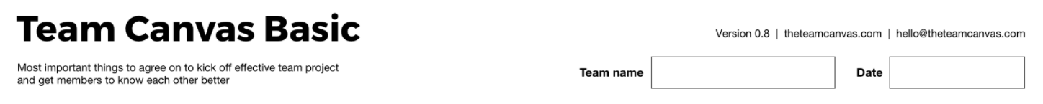
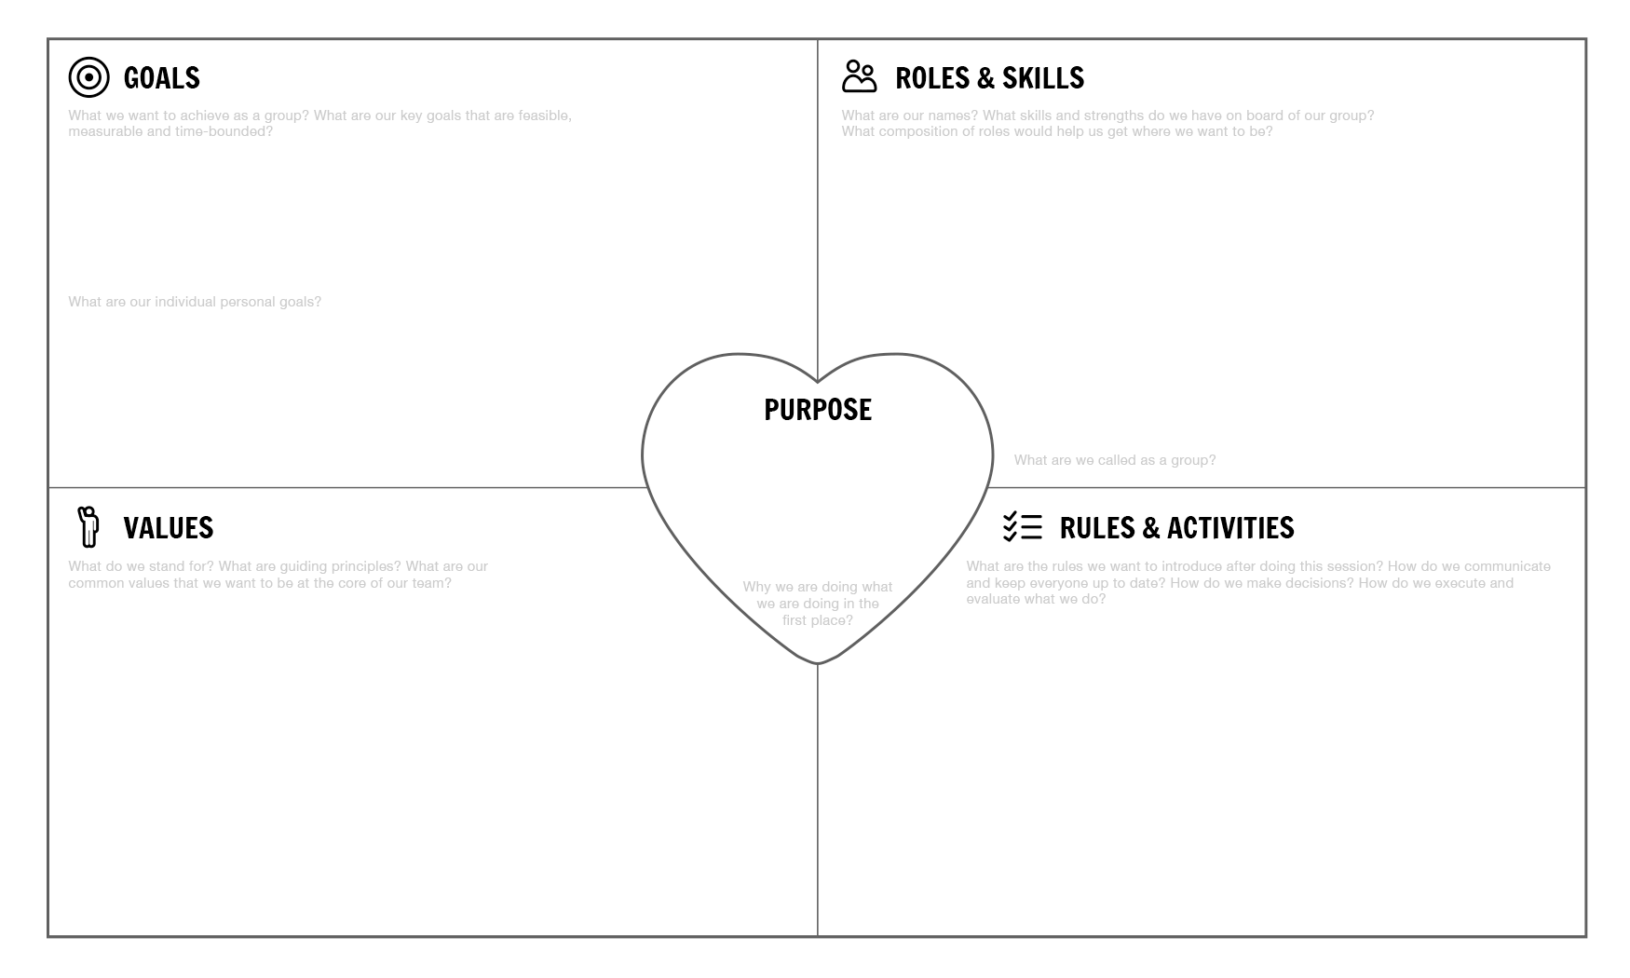
Team
Canvas
Notes:
With the Team Canvas you define all aspects for a successful cooperation in writing.
It's best to start in the middle: What is the purpose of the team? Why do we work together?
Then follow GOALS, your goals.
What are the goals, both for the entire team and for each individual team member?
At ROLES you can enter the newly learned Belbin roles together with your name.
If a central role has not yet been clearly assigned, you can also note this.
In RULES you write down the basic rules you want to agree on.
How will you communicate with each other?
How do you want to make decisions? > here there is a difference between consensus and majority decisions.
How do you plan?
What are your central accomplishments?
Do you want to set fixed deadlines for this, or stay flexible?
Finally, your VALUES.
What are the values that you share and that should also make you feel as a team?
Go back to your fictional groups. Imagine that you would now do your project work in this one. Populates the Team Canvas together. Pay attention to both your and other skills.

